Slide 1

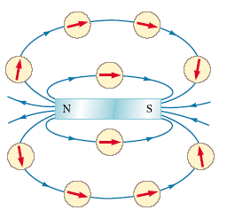
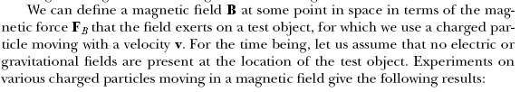
An electric field surrounds any stationary or moving electric charge.
In addition to an electric field, the region of space surrounding any moving electric charge also contains a magnetic field.
A magnetic field also surrounds any magnetic substance.
The symbol B has been used to represent a magnetic field.

Slide 2

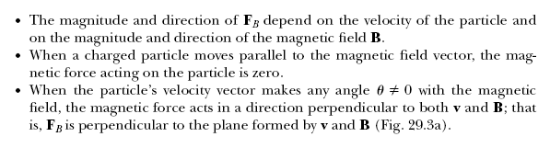
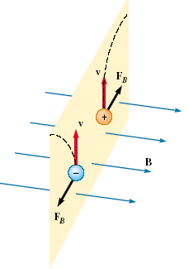
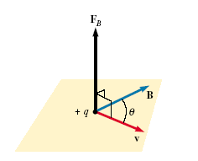

Slide 3
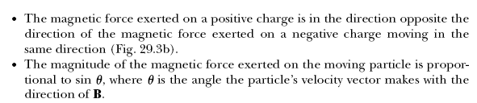

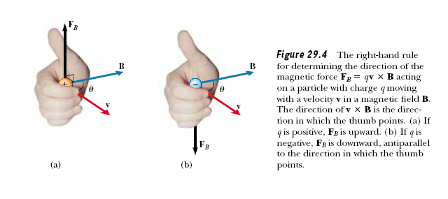

Slide 4



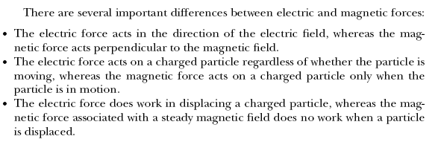

Slide 5


http://fys.kuleuven.be/pradem/applets/suren/MovChgMag/MovChgMag.html

Slide 6

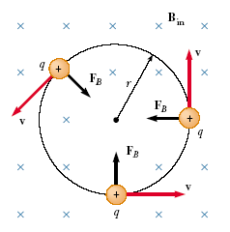
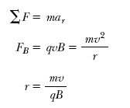


A positively charged particle moving in a uniform magnetic field with the initial velocity vector of the particle perpendicular to the field. Let us assume
that the direction of the magnetic field is into the page. Figure shows that the particle moves in a circle in a plane perpendicular to the magnetic field. The particle moves in this way because the magnetic force FB is at right angles to v and B and has a constant magnitude qvB. As the force deflects the particle, the directions of v and FB change continuously, as Figure shows. Because FB always points toward the center of the circle, it changes only the direction of v and not its magnitude.
If q were negative, the rotation would be clockwise.
These results show that the angular speed of the particle and the period of the circular motion do not depend on the linear speed of the particle or on the radius of the orbit. The angular speed is often referred to as the cyclotron frequency because charged particles circulate at this angular speed in the type of accelerator called a cyclotron,

Slide 7



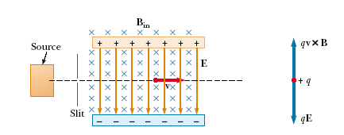


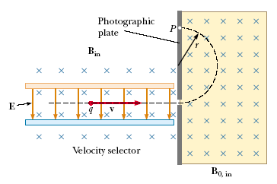



A variation of this technique was used by J. J. Thomson
(1856–1940) in 1897 to measure the ratio e/me for electrons.

Slide 8


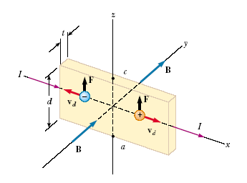




When a current-carrying conductor is placed in a magnetic field, a potential difference is generated in a direction perpendicular to both the current and the magnetic field. This phenomenon, first observed by Edwin Hall (1855–1938) in 1879, is known as the Hall effect.
The Hall effect gives information regarding the sign of the charge carriers and their density; it can also be used to measure the magnitude of magnetic fields.

Slide 9


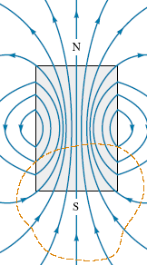
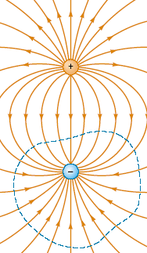
An isolated magnetic poles (monopoles) have never been detected and perhaps do not exist.
The magnetic field
lines of a bar magnet form closed
loops. Note that the net magnetic
flux through the closed surface
(dashed red line) surrounding one
of the poles (or any other closed
surface) is zero.
The electric field lines surrounding an electric dipole begin on the positive charge and terminate on the negative
charge. The electric flux through a
closed surface surrounding one of
the charges is not zero.

Slide 10
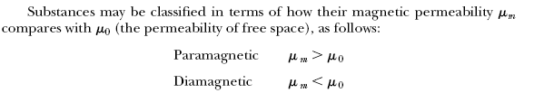

Substances can be classified as belonging to one of three categories, depending on
their magnetic properties. Paramagnetic and ferromagnetic materials are those
made of atoms that have permanent magnetic moments. Diamagnetic materials
are those made of atoms that do not have permanent magnetic moments.

Slide 11
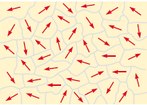
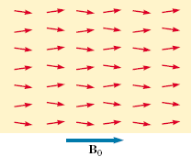
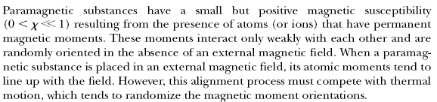
A small number of crystalline substances in which the atoms have permanent magnetic moments exhibit strong magnetic effects called ferromagnetism.
Some examples of ferromagnetic substances are iron, cobalt, nickel, gadolinium, and dysprosium.
All ferromagnetic materials are made up of microscopic regions called domains, regions within which all magnetic moments are aligned. These domains have volumes of about 10^12 to 108 m3 and contain 10^17 to 10^21 atoms. The
boundaries between the various domains having different orientations are called domain walls.

Slide 12

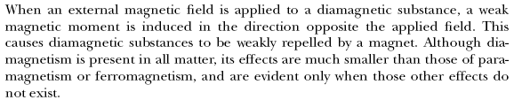

Slide 13
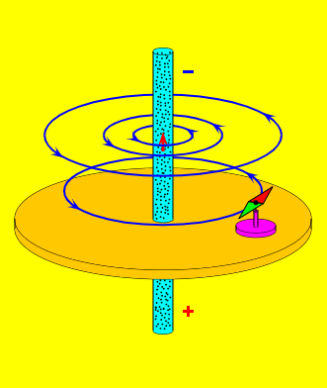

Slide 14
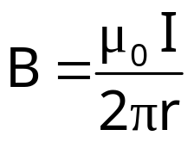
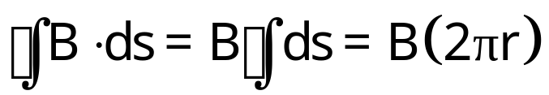
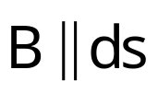
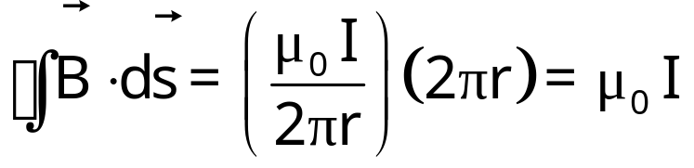
magnetic field of long straight wire:
winds around the wire
I
B
ds
Line integral of B over a closed circular path around wire:
r
Is this an accident, valid only for this particular situation?

Slide 15
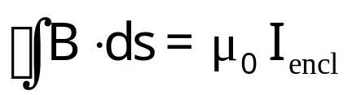
Ampere’s Law
Ampere’s Law
I_{encl} is total current that passes through surface bounded by closed path of integration.
law of nature: holds for any closed path and any current distribution
current I counts positive if integration direction is the same as the direction of B from the right hand rule
I
I
positive I
negative I
B
ds
B
ds
r
r

Slide 16
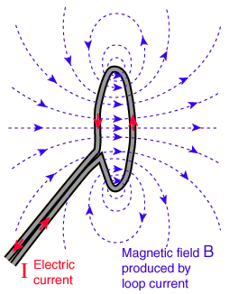
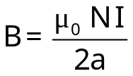
Magnetic Field of a Solenoid
A solenoid is made of many loops of wire, packed closely to form long cylinder.
Single loop:
images from hyperphysics.
*But not so closely that you can use

Slide 17
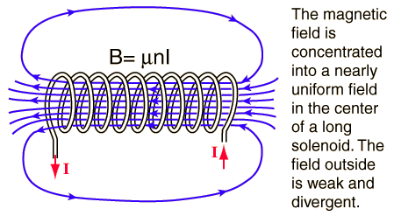
Stack many loops to make a solenoid:
Ought to remind you of the magnetic field of a bar magnet.

Slide 18
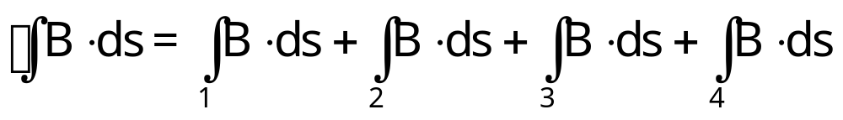

           
B
❶
◉           
I
❷
❹
❸
l
Use Ampere’s law to calculate the magnetic field of a solenoid:
N is the number of loops enclosed by our surface.

Slide 19
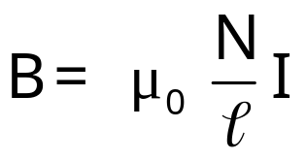

           
B
❶
◉           
I
❷
❹
❸
l
Magnetic field of a solenoid of length l , N loops, current I. n=N/l (number of turns per unit length).
The magnetic field inside a long solenoid does not depend on the position inside the solenoid (if end effects are neglected).

Slide 20
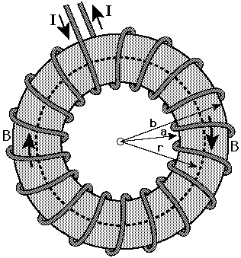

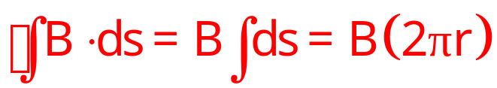
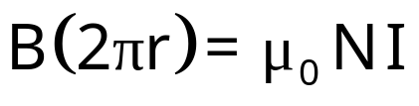
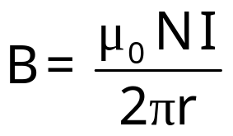
A toroid* is just a solenoid “hooked up” to itself.
Magnetic field inside a toroid of N loops, current I.
B
The magnetic field inside a toroid is not subject to end effects, but is not constant inside (because it depends on r).
*Your text calls this a “toroidal solenoid.”

Slide 21
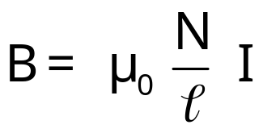
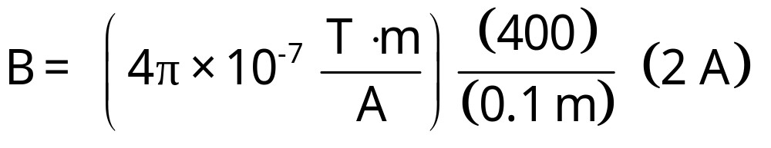

Example: a thin 10-cm long solenoid has a total of 400 turns of wire and carries a current of 2 A. Calculate the magnetic field inside near the center.

Slide 22
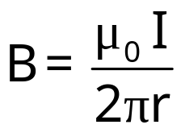
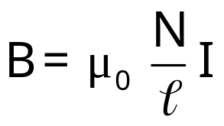
“Help! Too many similar starting equations!”
long straight wire
solenoid, length l, N turns
solenoid, n turns per unit length
toroid, N loops

Slide 23
Q1:
A wire with a resistance of 6.0 ohm is drawn out through a die so that its new length is three times its original length. Find the resistance of the longer wire, assuming that the resistivity and density of the material are unchanged.

Slide 24
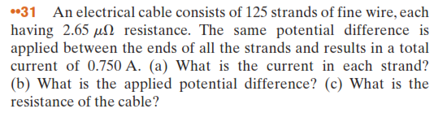

Slide 25
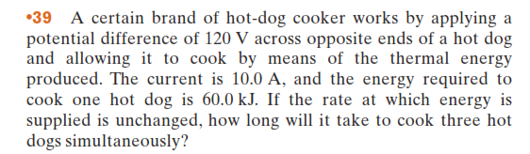


Slide 26
